Slide 1

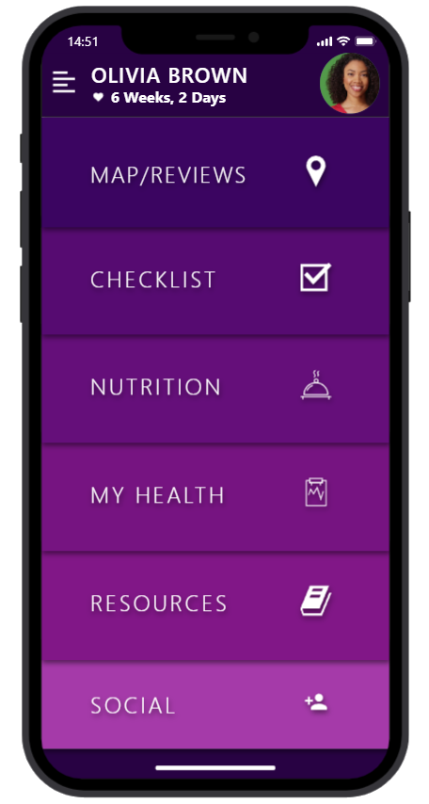

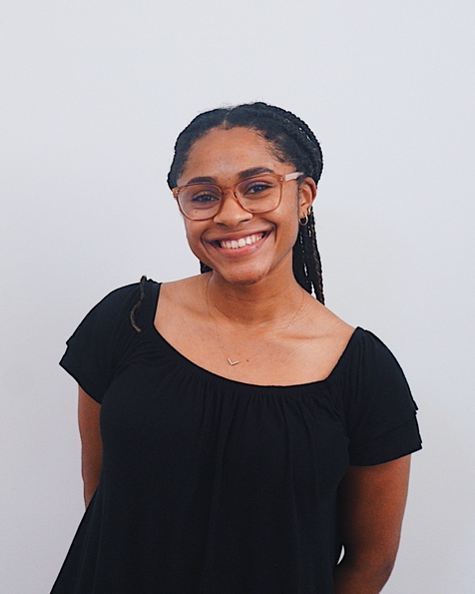




Tori Davis
Arrisa Morris
Lorena Morgan
Andy Charlorin

Slide 2

Preeclampsia
Problem
In Black Women
Vision
Maternal Mortality Report (Georgia): responsible for 13% of pregnancy-related deaths among Black women as 3rd leading cause of death
Accounts for 9% of pregnancy-related deaths among those less than 25 years old and 21% of pregnancy-related deaths among those 35 years old and older.
Preeclampsia is a pregnancy complication characterized by:
High blood pressure after the 20th week of pregnancy
Signs of damage to organ systems
most often the liver and kidneys
We hope that with the use of MotherBear...
The rates of preeclampsia and eclampsia will be lowered
Goal: percentage drop to around 5%
Preeclampsia is no longer in the top 5 leading causes of pregnancy-related death among Black women
Maternal mortality. Georgia Department of Public Health. (n.d.). Retrieved September 25, 2021, from https://dph.georgia.gov/maternal-mortality.

Slide 3
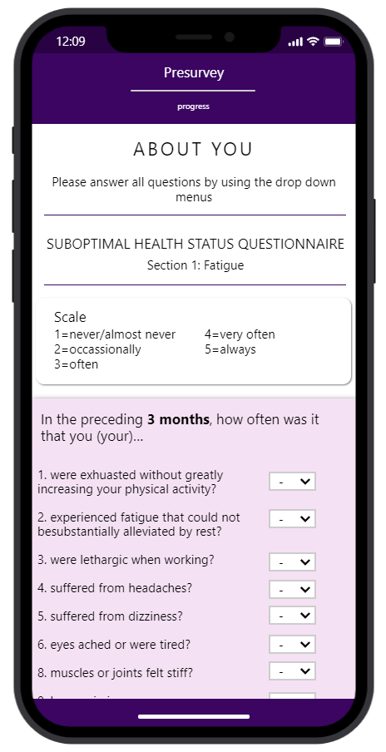
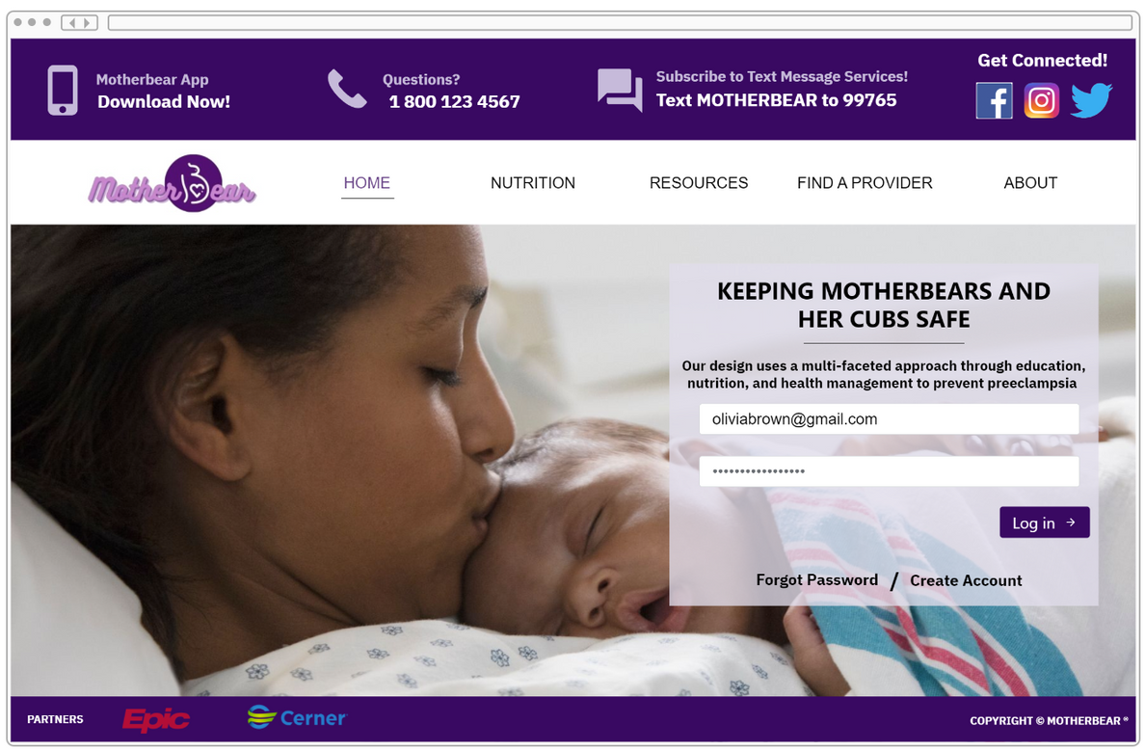
prototype
Website with a smartphone app companion
Improve accessibility to those without a smartphone
Subscribe to SMS message services (reminders, education, recipes)
97% of Americans own a cellphone of some kind
Presurvey: SHSQ-25
Included health concerns are associated with chronic diseases leading to increased preeclampsia risk
Individualize MotherBear experience
Demographics of mobile device ownership and adoption in the United States. Pew Research Center. (2021). Retrieved September 25, 2021, from https://www.pewresearch.org/internet/fact-sheet/mobile/

Slide 4
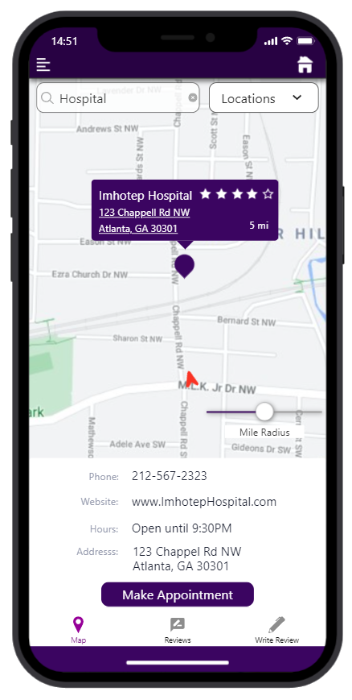
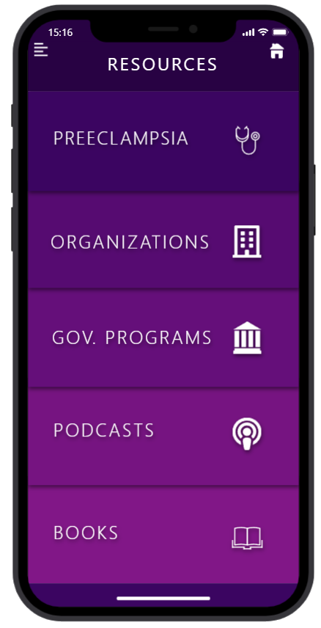
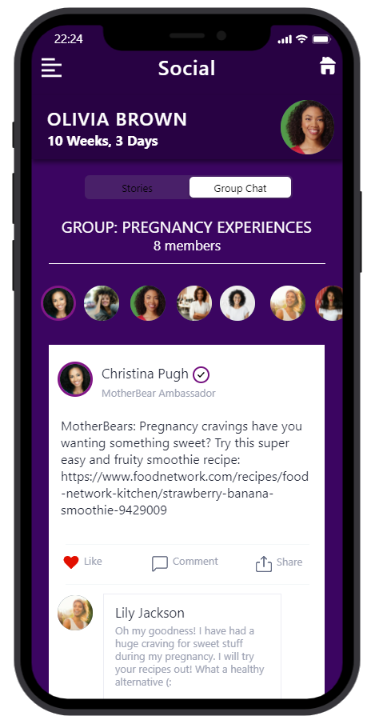
prototype
Provider Search
Resources
Social
Geofencing
Easy access to make appointments
Reviews by users
Education
Symptoms
Preeclampsia Foundation
Free BP Cuff
WIC/SNAP
MotherBear community
Connect with users and share stories
Speak with ambassadors

Slide 5
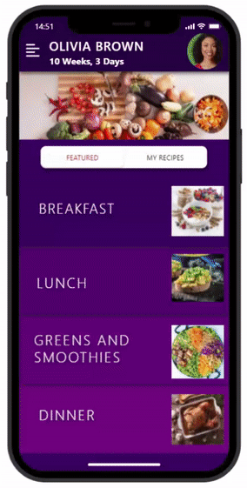
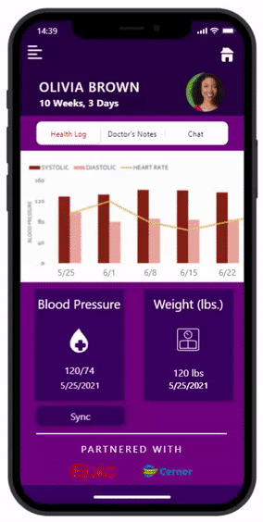

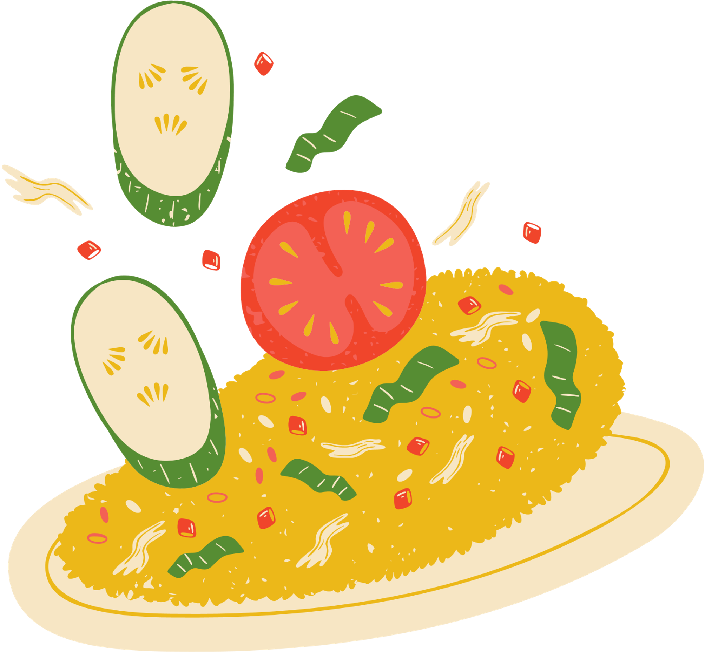
prototype
1
My Health
Track BP (manually/Bluetooth)
Access to EHR
Improve communication with providers
Doctor's notes
Chat function/telehealth
Provider can track health data
2
Nutrition
Provide recipes with essential nutrients
Users can save and upload recipes
Promote healthy eating habits
Decrease morbidity hypertension + obesity: compounding factors of preeclampsia
Notes:
Due to a familial history of hypertension and diabetes, her doctor does note that Olivia could be susceptible and discusses ways to not go down the same path.

Slide 6

Implementation
Month 1-3
Month 4-6
Month 7-9
Development Phase
Partner with app developers
Integrate other apps (maps, calendar, apple health)
Funding Phase
Funding opportunities
Partner with medical providers
EHR systems within GA
Partner organizations (WIC, SNAP)
Pilot Phase
3 Peri-Urban communities in GA
Majority African American Populations
Test and obtain feedback/data
Scale project accordingly

Slide 7
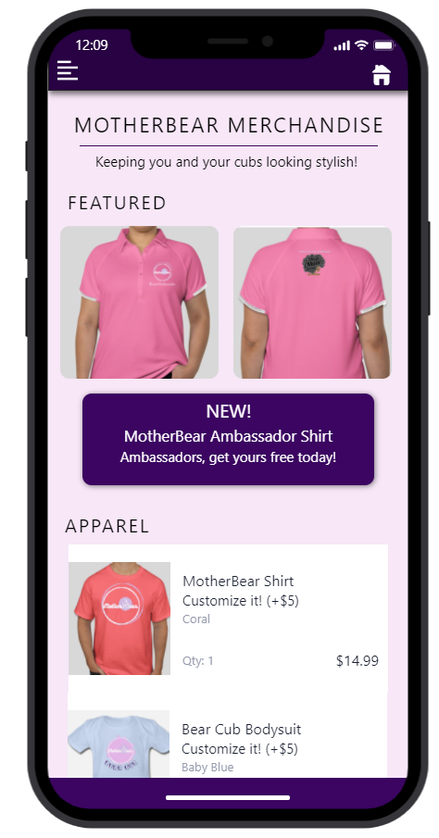
what we need
Further guidance
Advisory panel
1
Pilot population
Test platform's efficacy
Obtain feedback and scale up
2
Software engineers/developers
Design and flesh out platform
Create Android version
3
Funding
Finance additional development
4
Notes:
Information about monetization?

Slide 8
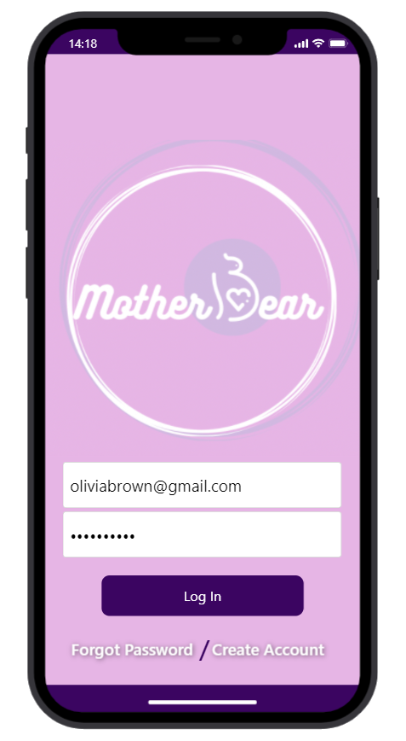
THANK YOU FOR LISTENING!
QUESTIONS?

